Slide 1


Digital Control in Power Electronics
杭丽君
ljhang@hdu.edu.cn
可再生能源及微型电力网技术实验室
Regeneration energy and microgrid Technology Lab(REMT)

Slide 2
课 程 内 容
Introduction: Power Electronic Converters
Introduction: Digital Control Application to Power Electronic Circuits
Introduction: Digital control of high frequency switched mode power converters

Slide 3
1.1 Basic Converter Topologies
Power electronic converters: the switches are operated only in one of two states - either fully ON or fully OFF, unlike other types of electrical circuits where the control elements are operated in a (near) linear active region.
switching frequency
distortion
are typical of the issues which must be considered when developing modulation strategies for a particular family of converters.
Parameters
losses
harmonic generation
speed of response

Slide 4
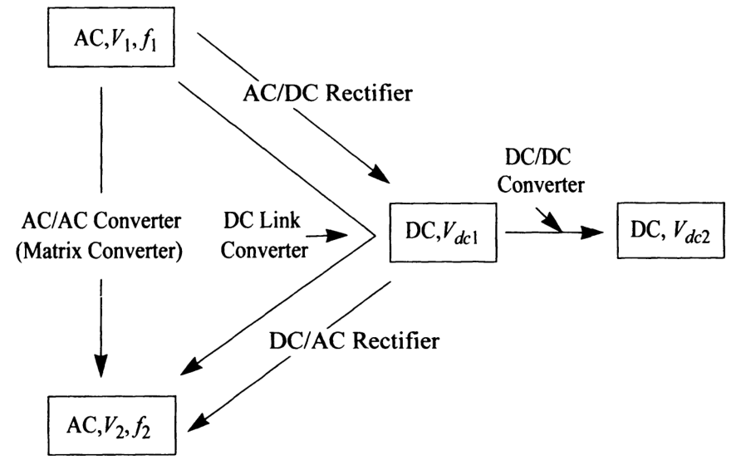
1.1 Basic Converter Topologies
Families of solid state power converters categorized according to their conversion function.

Slide 5
1.1.1 Switch Constraints
Kirchoff's voltage and current laws
1. The switch cannot be placed in the same branch with a current source (i.e., an inductance) or else the voltage across the inductor (and consequently across the switch) will become infinite when the switch turns off. At least one of the elements in branches connected via a node to the branch containing the switch must be non-inductive for the same reason.
2. The switch cannot be placed in parallel with a voltage source (i.e., a true source or a capacitance) or else the current in the switch will become infinite when the switch turns on. If more than one branch forms a loop containing the switch branch then at least one of these branch elements must not be a voltage source.

Slide 6
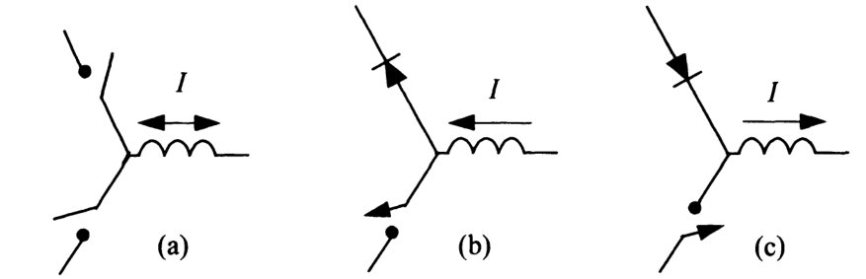
1.1.1 Switch Constraints
Basic commutation cells of power electronic converters using
(a) bidirectional switches and (b) and (c) unidirectional switches.

Slide 7
1.1.1 Switch Constraints
step-down chopper: The circuit is connected such that the current source (inductance) is connected to the load and the diode to the source.
step-up chopper: If the terminals associated with input and output are reversed. Energy is passed from the voltage source to the current "source" (i.e., the load) in the case of the step-down converter, and from the current source to the voltage "source" (load) in the case of the step-up converter.

Slide 8
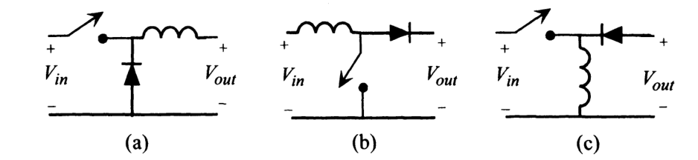
1.1.2 Bidirectional Chopper
In cases where power flow must occur in either direction a combination of a step-down and a step-up chopper with reversed polarity can be used as shown below.
The three basic DC/DC converters implemented with a basic switching cell (a) step-down chopper, (b) step-up chopper, and (c) up-down chopper.

Slide 9
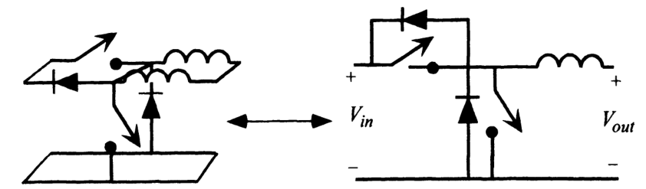
1.1.3 Single-Phase Full-Bridge (H-Bridge) Inverter
Bidirectional chopper using one up-chopper and one down-chopper. Current can flow bidirectionally in the current source/sink of the up-down chopper.

Slide 10
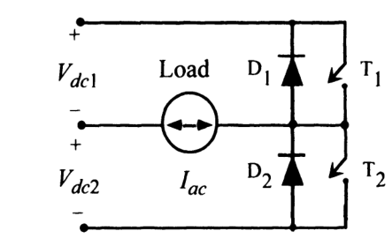
1.1.3 Single-Phase Full-Bridge (H-Bridge) Inverter
Note that in this case the input voltage is normally center-tapped into two equal DC voltages, V_{dc1} = V_{dc2} = V_{dc} , in order to produce a symmetrical AC voltage waveform. The total voltage across the DC input bus is then 2V_{dc} .
The parallel combination of the unidirectional switch and inverse conducting diode forms the first type of practical inverter switch. The switch combination permits unidirectional current flow but requires only one polarity of voltage blocking ability and hence is suitable, in this case, for operating from a DC voltage source.
Half-bridge single-phase inverter.

Slide 11
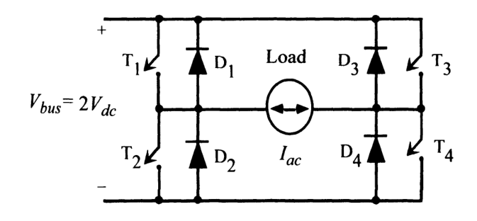
1.1.3 Single-Phase Full-Bridge (H-Bridge) Inverter
the maximum output voltage for this inverter is now twice that of the half-bridge inverter since the entire DC voltage can be impressed across the load, rather than only one-half as is the case for the half-bridge. This implies that for the same power rating the output current and the switch currents are one-half of
those for a half-bridge inverter. At higher power levels this is a distinct advantage since it requires less paralleling of devices. Also, higher voltage is preferred since the cost of wiring is typically reduced as well as the losses in many types of loads because of the reduced current flow.
Single-phase full-bridge (H-bridge) inverter.

Slide 12
1.1.3 Single-Phase Full-Bridge (H-Bridge) Inverter
Inverters: In the case where power is exclusively or primarily intended to flow from DC to AC.
Rectifiers: while the same circuits are designated if the reverse is true. AC to DC.
voltage source inverter (VSI): In cases where the DC supplies are derived from a source such as a battery.
voltage stiff inverter: If the DC is formed by a temporary DC supply such as a capacitor, the inverter is designated to indicate that the link voltage tends to resist sudden changes but can alter its value substantially under heavy load changes. The same distinction can also be made for the rectifier designations.

Slide 13
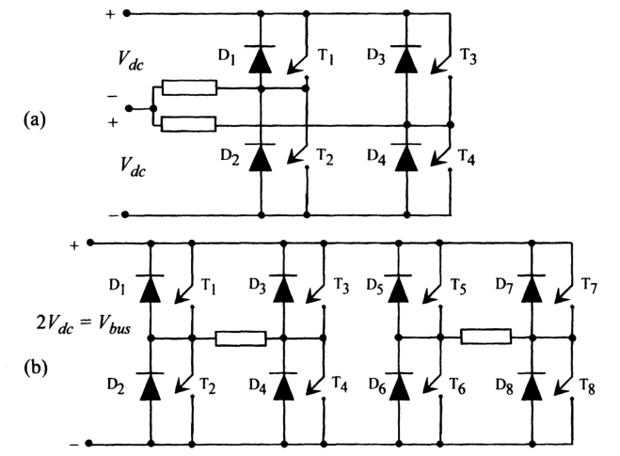
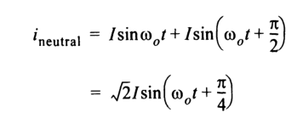
1.2.1 Voltage Source/Stiff Inverters: Two-Phase Inverter Structure
While the currents in the two phases can be controlled at will, the most desirable approach would be to control the two currents so that they are phase shifted by 90° with respect to each other (two-phase set) thereby producing a constant amplitude rotating field for an AC machine. However, note that the sum of the two currents must flow in the line connected to the center point of the DC supplies. If the currents in the two phases can be approximated by equal amplitude sine waves, then
Two-phase (a) half-bridge and (b) full-bridge inverters.

Slide 14
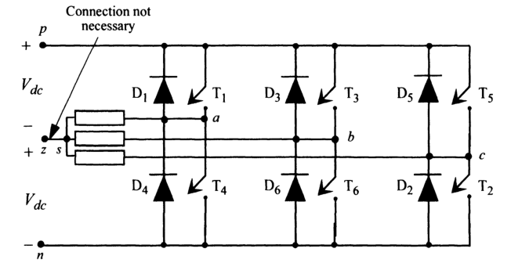
1.2.2 Three-Phase Inverter Structure
Operation of an AC motor requires that the three currents are a balanced three-phase set, equal amplitude currents with equal 120 phase displacement between them.
The sum of the three currents is zero, so that the connection back to the midpoint of the DC supply is not required. While the connection from point need not be physically present, it remains useful to retain the midpoint z as the reference (ground) for all voltages.
p and n: the positive and negative bus voltages respectively, with respect to the midpoint z.
Three-phase bridge-type voltage source inverter.

Slide 15
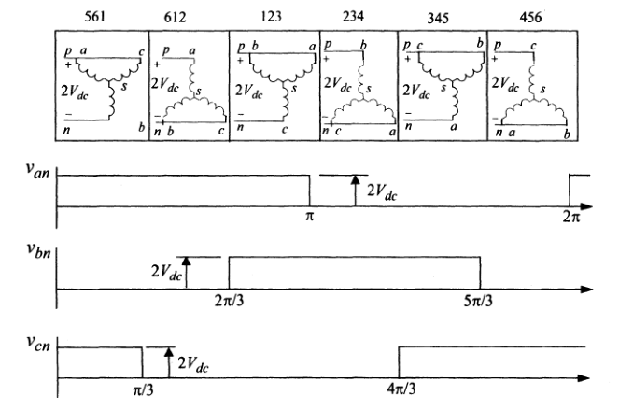
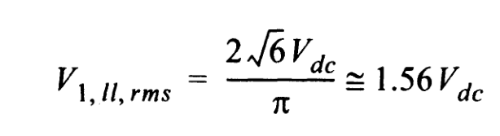
1.2.3 Voltage and Current Waveforms in Square-Wave Mode
the line-to-line voltage contains a root-mean-square (RMS) fundamental component of:
The six possible connections of a simple three-phase voltage stiff inverter. The three waveforms show voltages from the three-phase leg outputs to the negative DC bus
voltage.

Slide 16
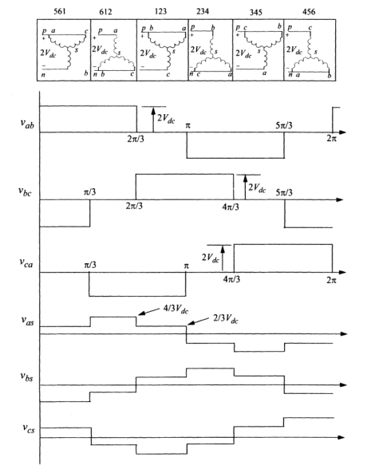




1.2.3 Voltage and Current Waveforms in Square-Wave Mode
The three line-to-line and line-to-neutral load voltages created by the six possible switch connection arrangements of a six-step voltage stiff inverter.

Slide 17
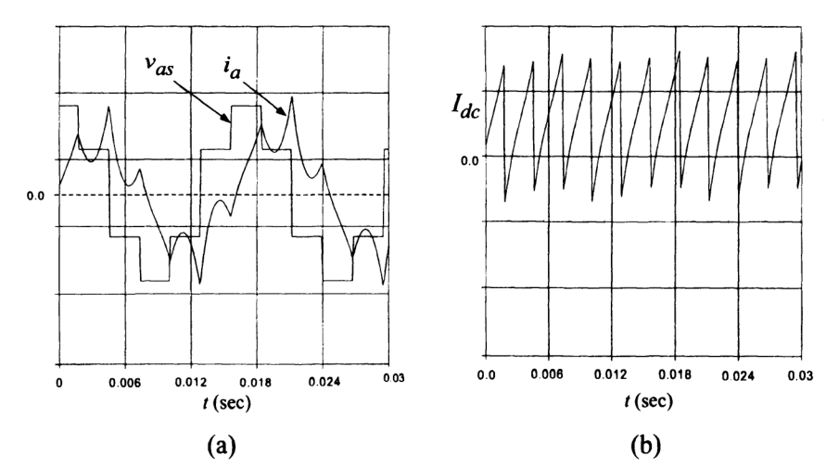
1.2.3 Voltage and Current Waveforms in Square-Wave Mode
Current flow in three-phase voltage stiff inverter: (a) phase voltage and current waveform, wye-connected load, and (b) DC link current.

Slide 18
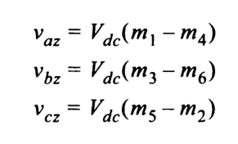
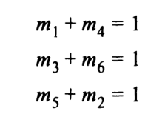
1.3 Switching Function Representation of Three-Phase Converters
Let m₁ , m₂ , ... , m₆ take on the value “+1” when switches T₁, T₂ , ... ,T₆ are closed and the value “zero” when opened. The voltages from the three-phase legs to the DC center point can then be expressed as
Considering now the constraints imposed by the circuit it is apparent that both the top and bottom switches of a given phase cannot be closed at the same time. Furthermore, from current continuity considerations in each phase leg

Slide 19

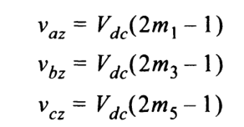


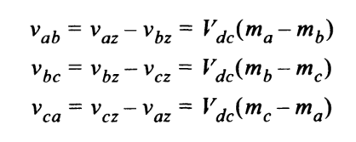
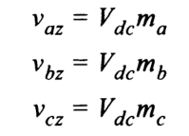
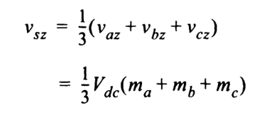
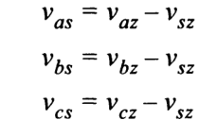
1.3 Switching Function Representation of Three-Phase Converters
define new variables m_{a} , m _{b} , m_{c} , such that m_{a} = 2m₁ - 1, etc.

Slide 20
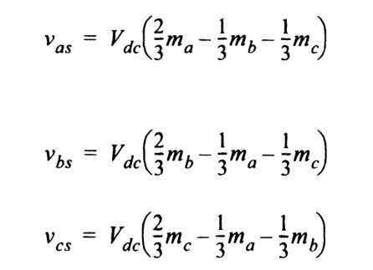

1.3 Switching Function Representation of Three-Phase Converters

Slide 21


1.4.1 Output Voltage Control: Volts/Hertz Criterion
Since the time rate of change of flux linkages in an inductive load is equal to the applied voltage, then
If one is only concerned with the fundamental component, then, if a phase voltage is of the form v = VI cosOlot , the corresponding flux linkage is
The fundamental component of voltage must be varied in proportion to the frequency if the amplitude of the flux in the inductive load is to remain sensibly constant.

Slide 22
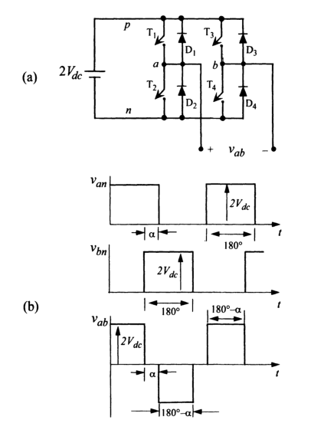

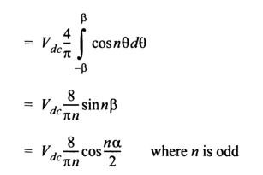
1.4.2 Phase Shift Modulation for Single-Phase Inverter
Full-bridge, single-phase inverter control by phase shift cancellation:
power circuit
(b) voltage waveforms.
phase shift voltage control or phase shift modulalion

Slide 23
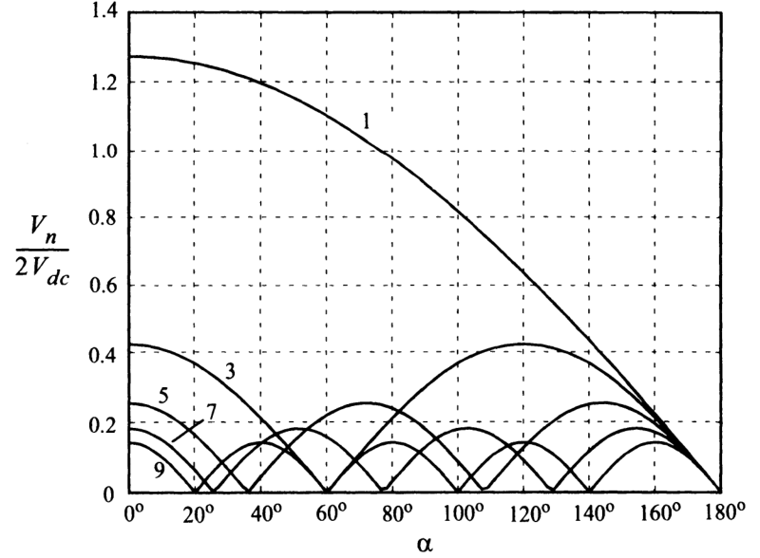
1.4.3 Voltage Control with a Double Bridge
First five odd (nonzero) harmonic components of single-phase inverter with phase shift control as a function of phase shift angle a normalized with respect to 2V_{dc .}

Slide 24
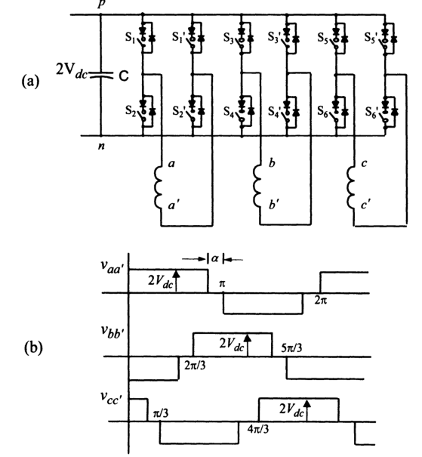
1.4.3 Voltage Control with a Double Bridge
Double three-phase bridge arrangement:
(a) basic circuit
(b) voltage waveforms.

Slide 25
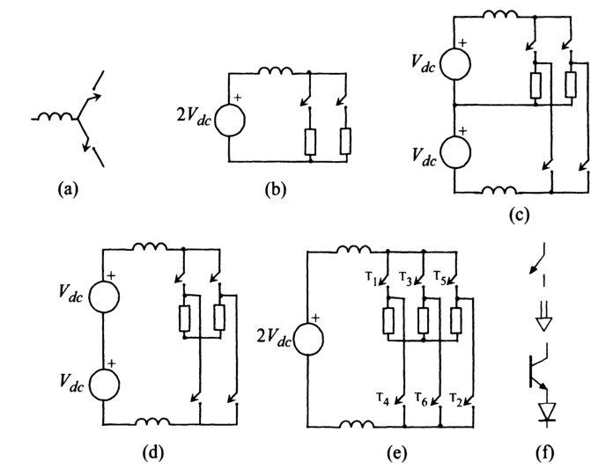
1.5 Current Source/Stiff Inverters
(a) the current source commutation cell.
(b) the inductor is chosen as the source so that
the switch branches become loads.
(c) In order to create AC currents in the load two such commutation cells are used - one to produce positive current and the other to produce negative current in the load.
(d) A single-phase bridge is produced by recognizing
that no current need flow in the center point
connection between the two current sources if they produce the same amplitude of current.
(e) a third phase is added in the same manner to produce a three-phase current source inverter.
(f) unidirectional current conducting switch is typically realized by a series-connected transistor and diode arrangement.
Evolution of three-phase current source/stiff inverter from basic commutation cell.

Slide 26
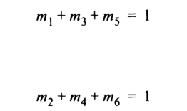
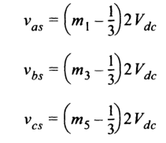
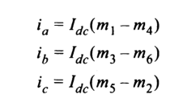
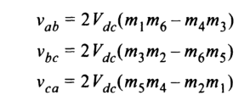
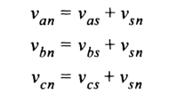
1.5 Current Source/Stiff Inverters
The basic switching strategy for this converter can again be summarized using switching functions. If m₁ , m₂ , … , m₆ are defined as +1 when switches T₁, T₂, ... ,T₆ are closed and zero when they are open, then to ensure current continuity in the DC side inductor, it is evident from current continuity considerations:
The load currents:
The line voltages:
The phase voltages:

Slide 27
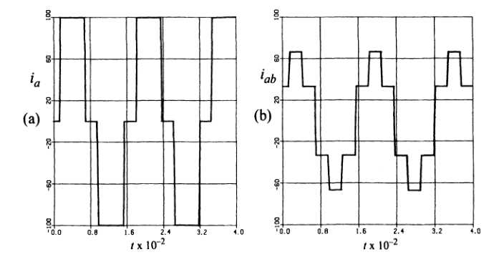
1.5 Current Source/Stiff Inverters
Current source inverter waveforms: (a) line current for a star-connected load and (b) phase current for a delta-connected load assuming a DC link current of 100 A.

Slide 28
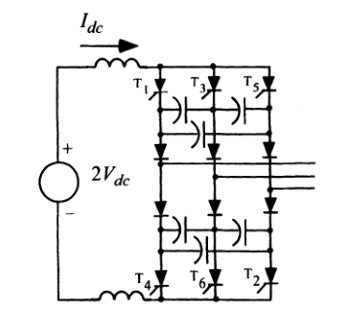
1.5 Current Source/Stiff Inverters
Autosequentially commutated current source/stiff converter.

Slide 29
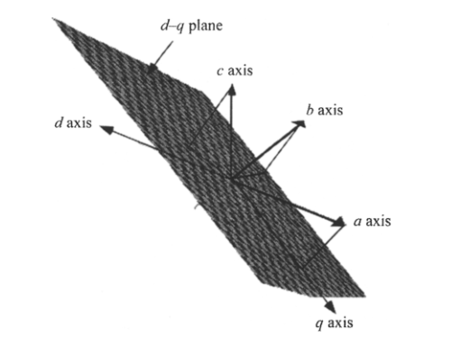
1.6 Concept of a Space Vector
The highly coupled nature of inverter loads such as induction and synchronous machines has led to the use of artificial variables rather than actual (phase) variables for the purpose of simulation as well as for visualization.
the sum of these three currents adds up to zero since most three-phase loads do not have a neutral return path. In this case, the stator current vector:
Cartesian coordinate system for phase variables showing location of the d-q plane and projection of phase variables onto the plane.

Slide 30
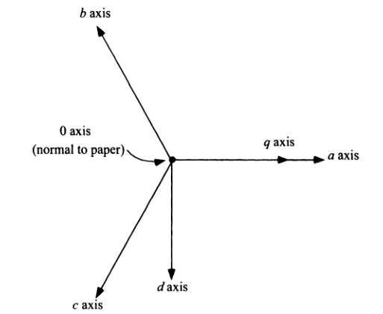
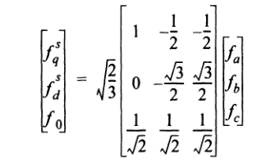
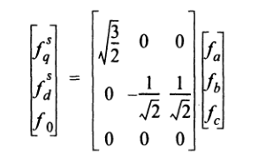
1.6 Concept of a Space Vector
Physical a-b-c and conceptual stationary frame d-q-0 axes
when viewed from an axis normal to the d-q plane.

Slide 31
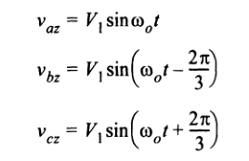


1.6.1 d-q-0 Components for Three-Phase Sine Wave Source/Load
When balanced sinusoidal three-phase AC voltages are applied to a three-phase load, typically, with respect to the supply midpoint z
s is the load neutral point, p represents the time derivative operator
p = d/(dt), and Z(P) denotes the impedance operator made up of an arbitrary circuit configuration of resistors, inductors, and capacitors.

Slide 32
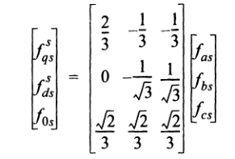
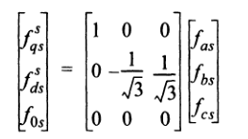
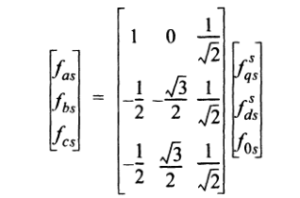
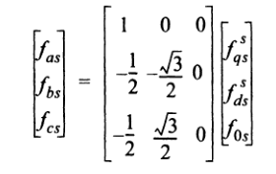
1.6.1 d-q-0 Components for Three-Phase Sine Wave Source/Load
When the projection of the vectoron the zerosequence
axis is zero

Slide 33
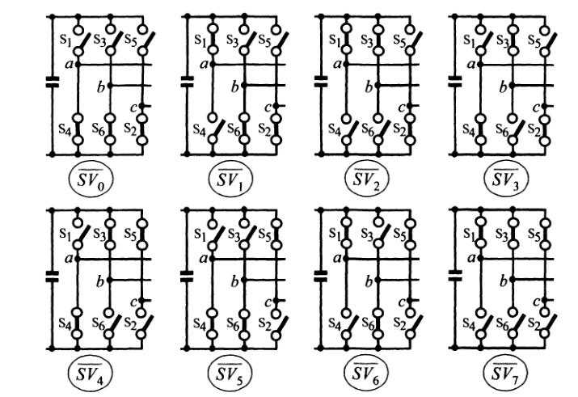
1.6.2 d-q-O Components for Voltage Source Inverter Operated in Square Wave Mode
The eight possible phase leg switch combinations for a VSI.

Slide 34
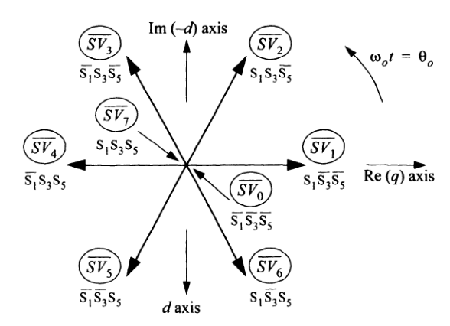
1.6.2 d-q-O Components for Voltage Source Inverter Operated in Square Wave Mode
Eight possible stationary vectors on the d-q plane for a VSI.

Slide 35
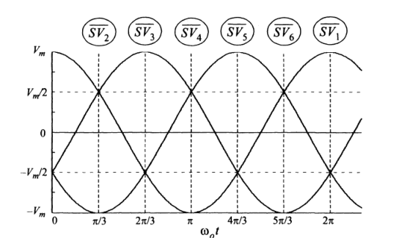
1.6.2 d-q-O Components for Voltage Source Inverter Operated in Square Wave Mode
VSI phasor angular positions in fundamental cycle for space vector.

Slide 36
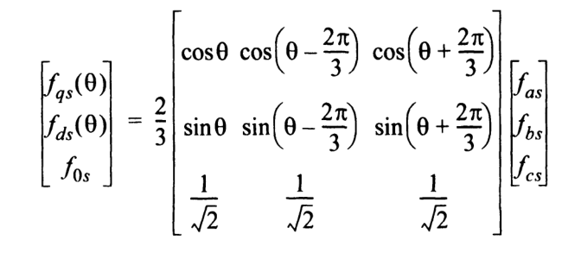
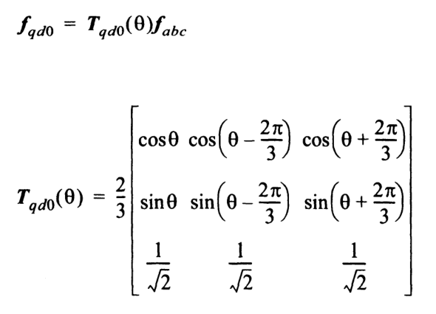
1.6.3 Synchronously Rotating Reference Frame
a general rotating transformation which transforms the phase variables to rotating axes on the d-q plane:
In vector notation

Slide 37

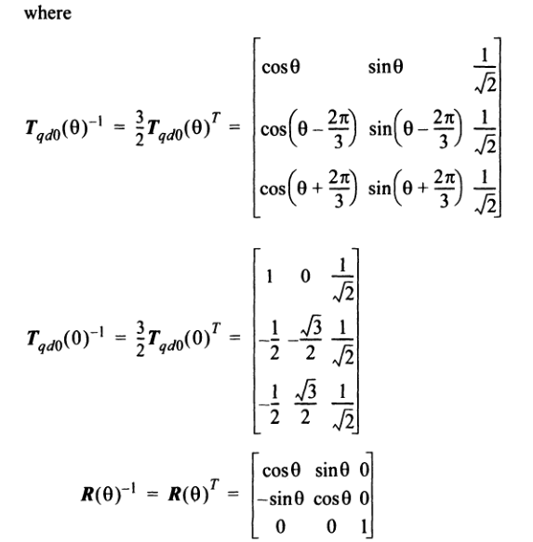
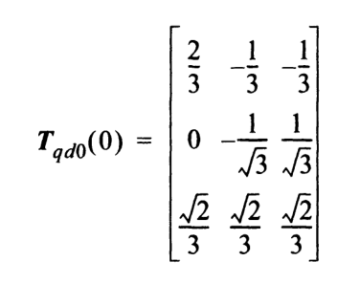
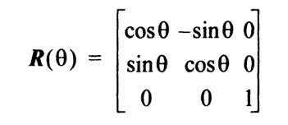


1.6.3 Synchronously Rotating Reference Frame
where

Slide 38

1.7 Three-Level Inverters
Three-level voltage source/stiff inverter.

Slide 39





1.7 Three-Level Inverters
the three terminal voltages:
The load neutral-to-inverter-midpoint voltage:
the line-to-line and line-to-neutral voltages (in the case of a star-connected load):
The three DC link currents:
where

Slide 40


1.7 Three-Level Inverters
Switched(a) line-to-midpoint, (b) line-to-lineand (c) line-to-neutral voltagesproducedby three-levelNPC inverter. Phase leg zero voltage step width arranged for minimumTHD.

Slide 41

1.8.1 Multilevel Inverter Topologies: Diode-Clamped Multilevel Inverter
Hexagons of possible switching states for three-level DC
voltage source/stiff inverter.

Slide 42

1.8.1 Diode-Clamped Multilevel Inverter
(a) Four-level and (b) five-level diode-clamped inverter
implementations (one phase only shown).

Slide 43

1.8.1 Diode-Clamped Multilevel Inverter
A seven-level diode-clamped inverter.

Slide 44

1.8.2 Capacitor-Clamped Multilevel Inverter
Topology of a five-level capacitor-clamped inverter.

Slide 45

1.8.2 Capacitor-Clamped Multilevel Inverter
Three-level capacitor-clamped inverter, voltage on
capacitors C₁ regulated to V_{dc}

Slide 46

1.8.3 Cascaded Voltage Source Multilevel Inverter
Seven-level series-bridge cascaded inverter.

Slide 47

1.8.3 Cascaded Voltage Source Multilevel Inverter
Isolated DC voltage supplies obtained from separate transformer secondary windings for 7-level cascaded multilevel inverter (one output phase only shown).

Slide 48

1.8.4 Hybrid Voltage Source Inverter
Topologyof a seven-level hybrid voltage source inverter.

